Slide 1
Food Insecurity in America
February 1, 2023

Slide 2
Project Description
Looked at food insecurity in Georgia
Food insecurity is defined by the USDA as “a household-level economic and social condition of limited or uncertain access to adequate food.”¹
Initially wanted to specifically investigate food deserts, which are defined as census tracts with at least 500 people who live more than one mile in urban areas or 10 miles in rural communities from the "nearest supermarket, supercenter, or large grocery store.”²
However, on further investigation, there is little access to food desert data specifically
As a result, we decided to focus on food insecurity for our analysis. Living in a food desert is a type of food insecurity, though not the only cause
All data from 2018
Combined data published by the Malcolm Weiner Center for Social Policy Data Visualization Lab
https://www.ers.usda.gov/topics/food-nutrition-assistance/food-security-in-the-u-s/definitions-of-food-security/
https://www.ers.usda.gov/data-products/food-access-research-atlas/documentation/#distance

Slide 3
Questions
We asked our data several questions:
Which counties in Georgia are the most food insecure?
Is there a relationship between the counties with food insecurity and high levels of obesity?
Do people in food insecure areas tend to be on public assistance?
[Insert Jinny’s Question]

Slide 4
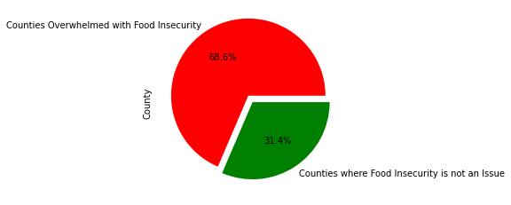
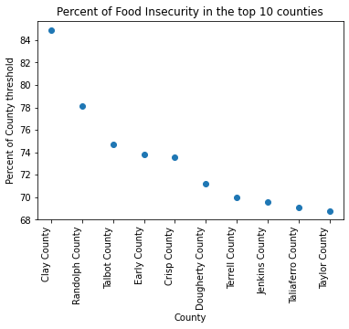
Many Counties in Georgia are Food Insecure
The top counties for food insecurity have a large portion of their population facing this problem.
[TBD]

Slide 5
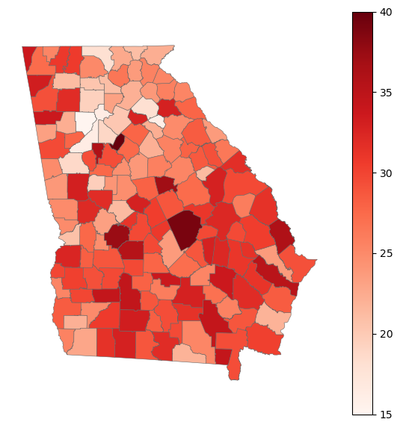
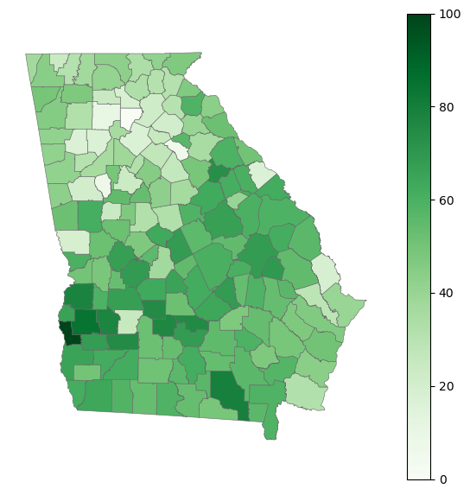
Obesity Tends to be Associated with Food Insecurity
Food Insecure Counties in Georgia
Obesity Rates in Counties in Georgia

Slide 6
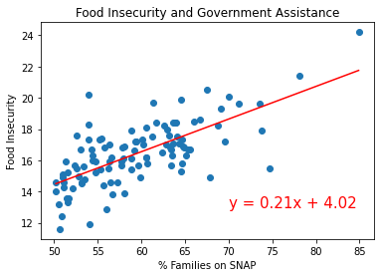
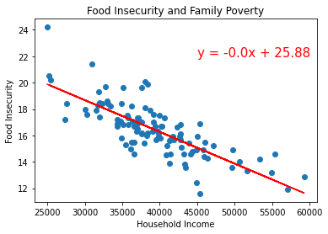
Poverty and Food Insecurity Go Hand-in-Hand
Government Assistance (SNAP) is Associated with Food Insecurity
Poverty is Associated with Food Insecurity

Slide 7
[TBD – Jinny’s Analysis]

Slide 8
Conclusions and Implications
Food insecurity is a large problem in Georgia
Nonprofits and governments should address food insecurity as part of their poverty reduction initiatives
Food insecurity tends to be correlated with obesity

